Slide 1
A GIS Pipeline to produce GeoAI Datasets from Drone Overhead Imagery
John R. Ballesteros
PhD. Engineering: Systems and Informatics, UNAL
MSc. GeonInformatics, ITC, The Netherlands
Geologist Engineer, UNAL
jballes@unal.edu.co
https://github.com/jrballesteros/GeoAI_Course
https://www.linkedin.com/in/johnrballesteros
www.medium.com/@jrballesteros
MockUp Lesson

Slide 2
Agenda
AI: Machine Learning and Deep Learning
GeoAI and GeoAI Datasets
Applications of GeoAI
A GIS Pipeline for GeoAI datasets
Roads, vehicle and buildings models trained on produced datasets

Slide 3
Machine Learning
Algorithms that learn directly from data instead of being explicitly programmed. (Random Forest, SVM, LogRegression, XGBoost, etc)
Deep Learning
Flexible mapping functions created by layers of neurons emulating how the brain Works. (DNN, CNN, RNN, GAN, etc)

Slide 4
GeoAI
A set of techniques at the intersection of AI and Geospatial Analysis for geographic knowledge discovery, representation and understanding.
Krzysztof Janowicz, Song Gao, Grant McKenzie, Yingjie Hu & Budhendra Bhaduri (2020) GeoAI: spatially explicit artificial intelligence techniques for geographic knowledge discovery and beyond, International Journal of Geographical Information Science, 34:4, 625-636, DOI: 10.1080/13658816.2019.1684500

Slide 5
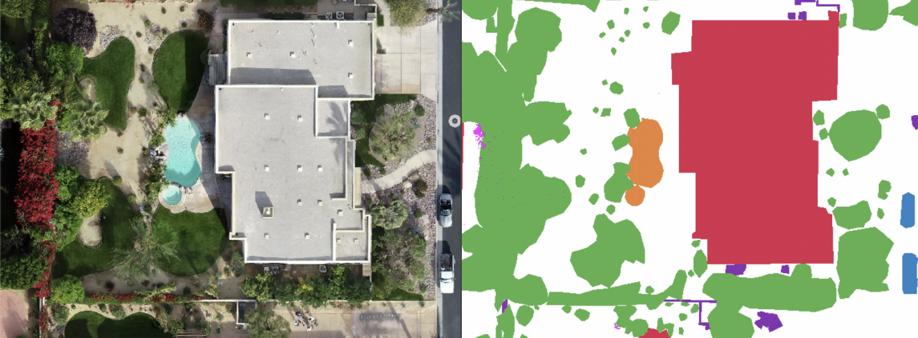
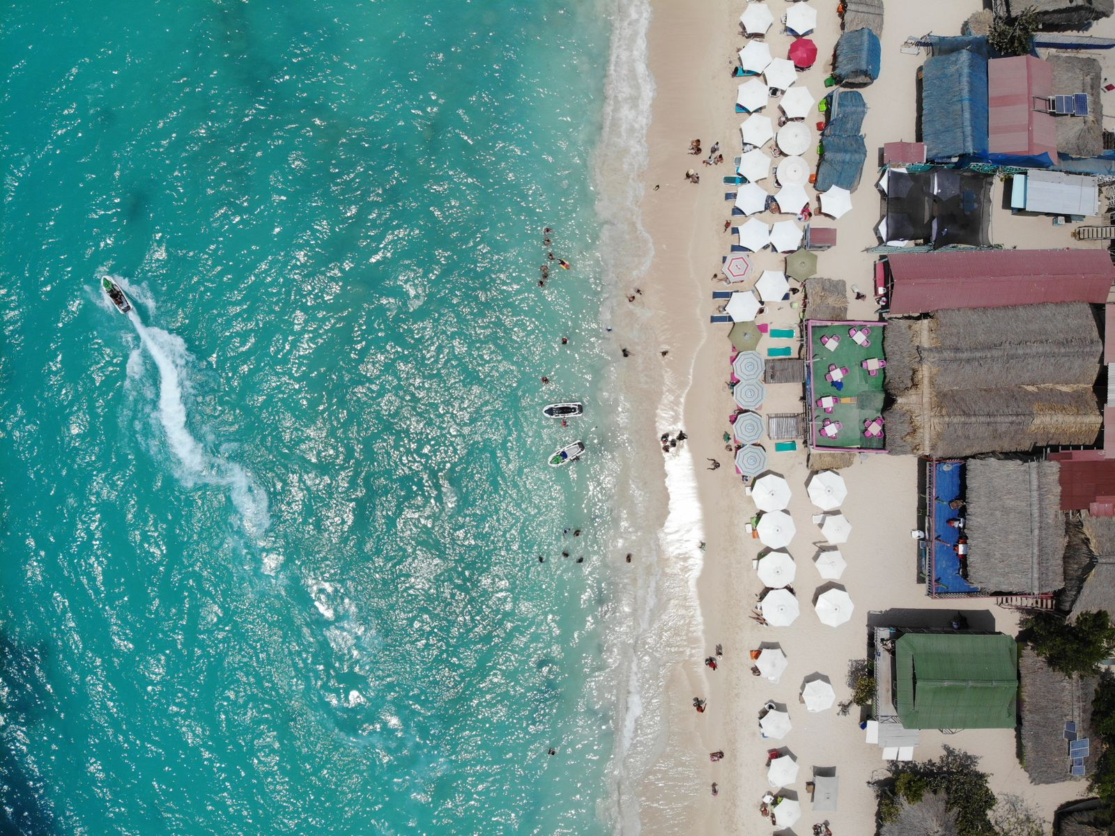
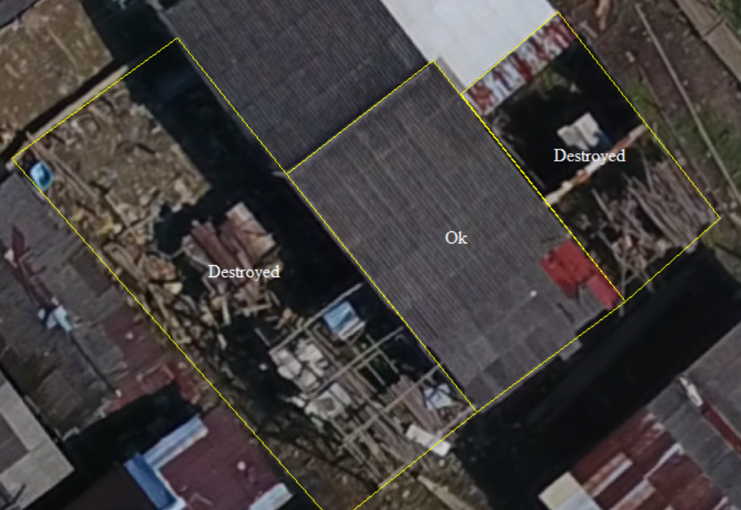
GeoAI Datasets
Unbiased and enhanced labelled geographic data features for models to learn
(Blaga and Nedevschi., 2020)
Human

Slide 6
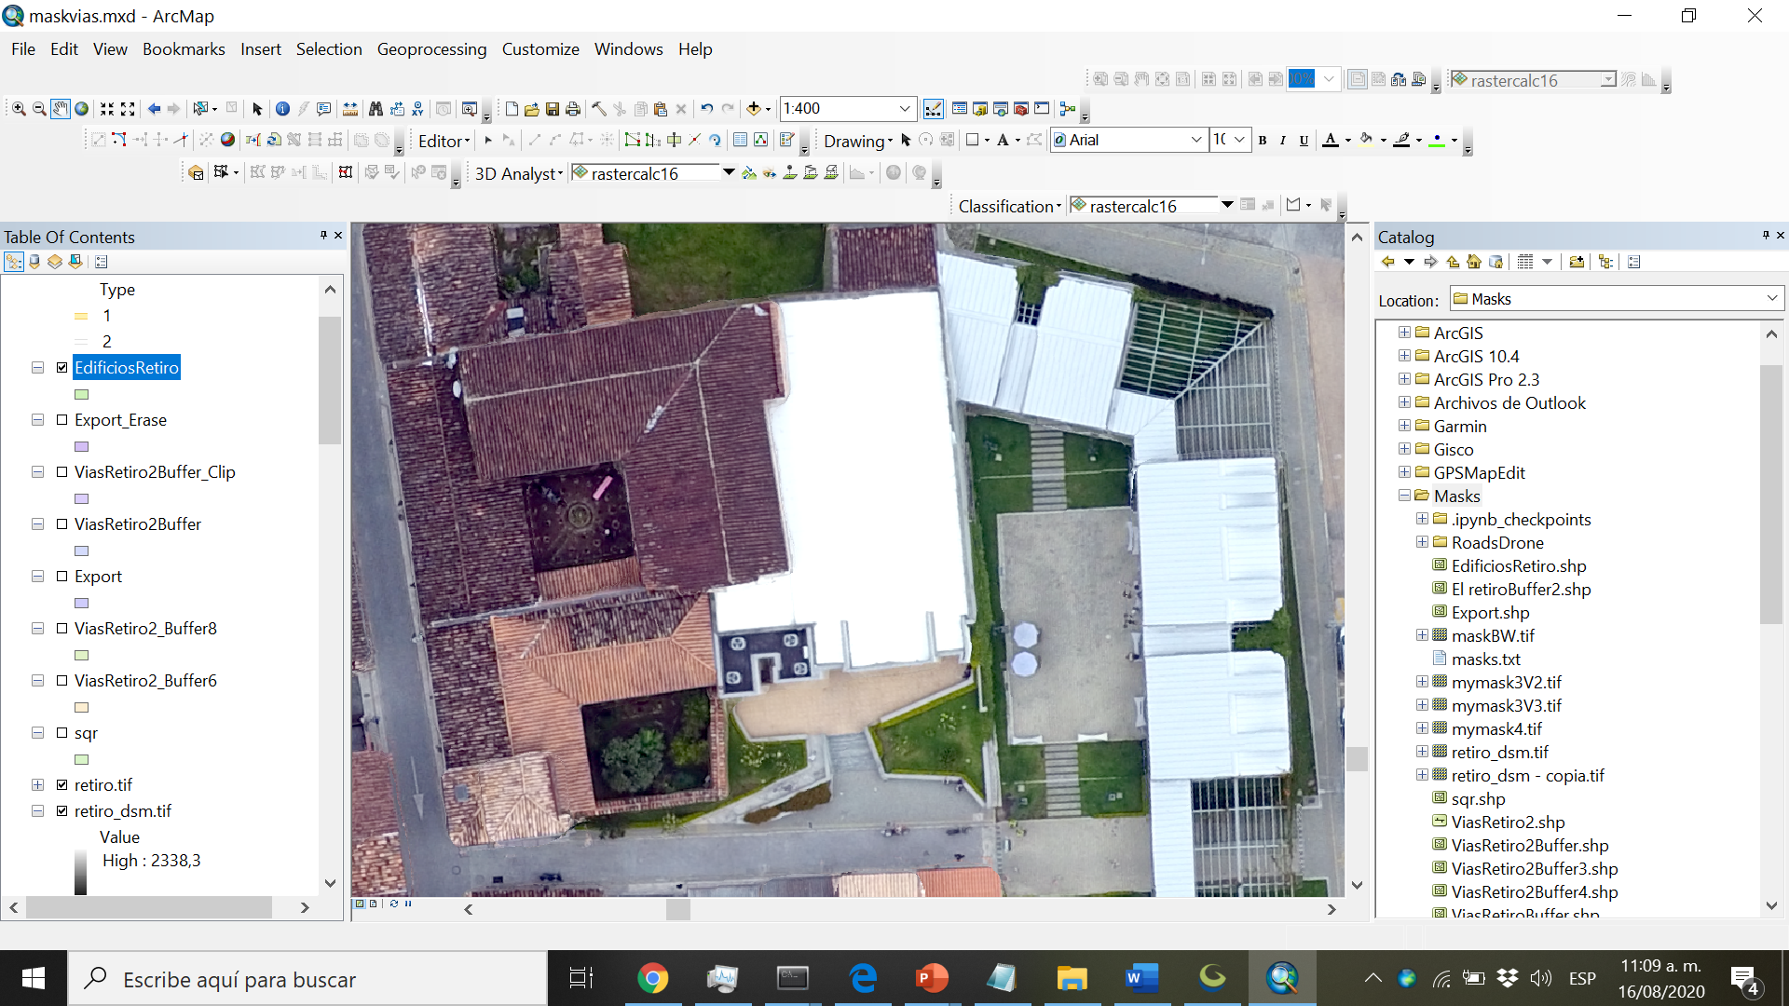
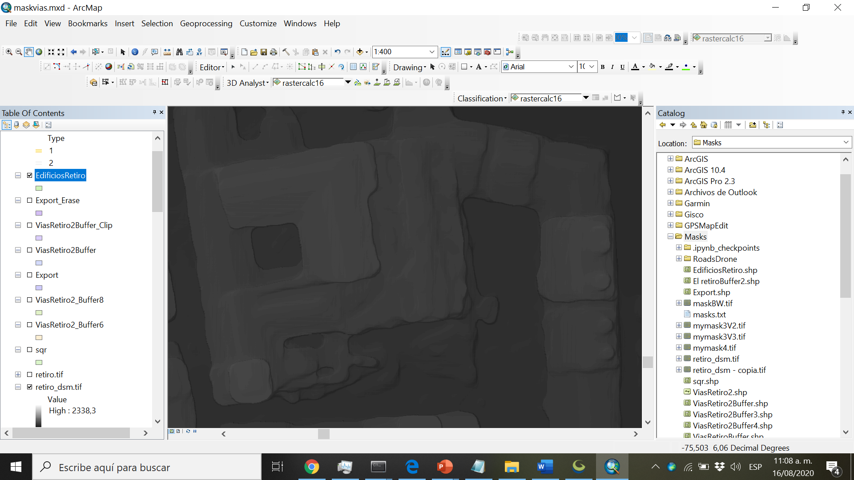
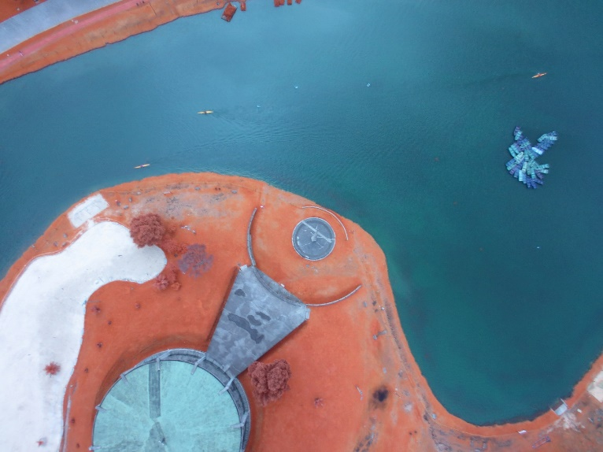
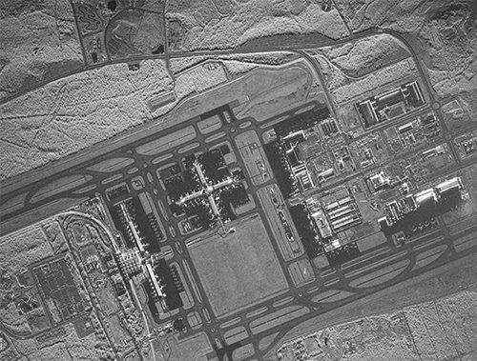
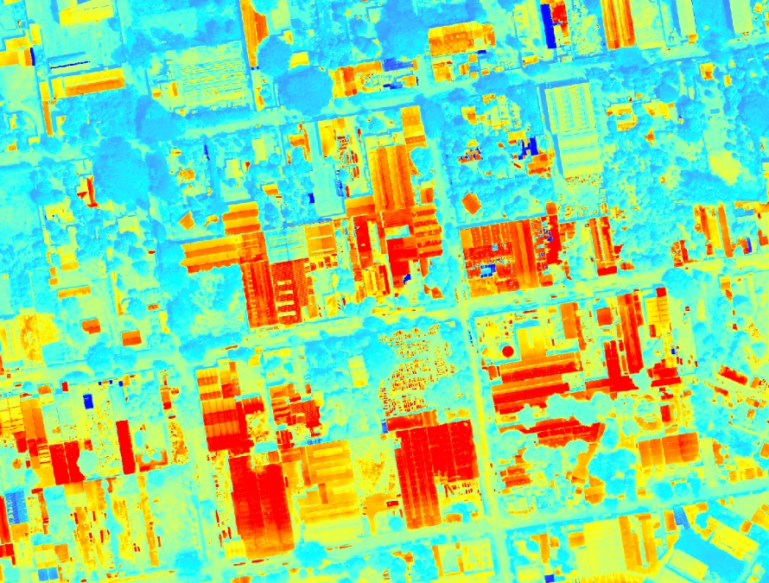
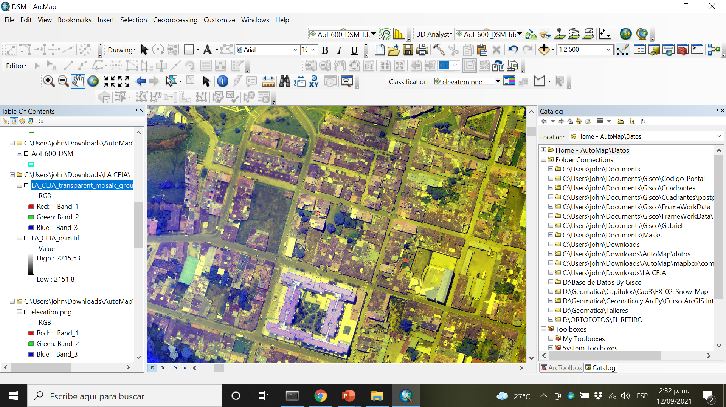
RGB
LIDAR
NIR
SAR
THERMAL
RG-DSM
(Abdollahi et al., 2020)

Slide 7
- Mapping & cartography (in minutes nor months) - Cadaster - Logistics and Routing - Disaster management (quick production of maps is needed) - Oil and Gas - Solar Energy - Urban Planning - Current environmental problems: Heat Islands
Applications
Encompassing the fast and increasing acquisition of aerial-drone-satellite imagery with the spatial analysis and map production for:

Slide 8
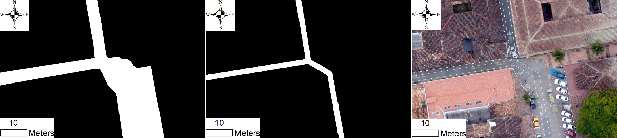
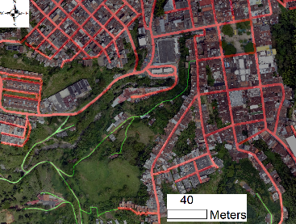
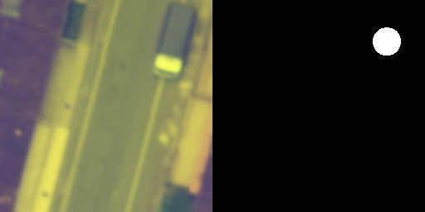
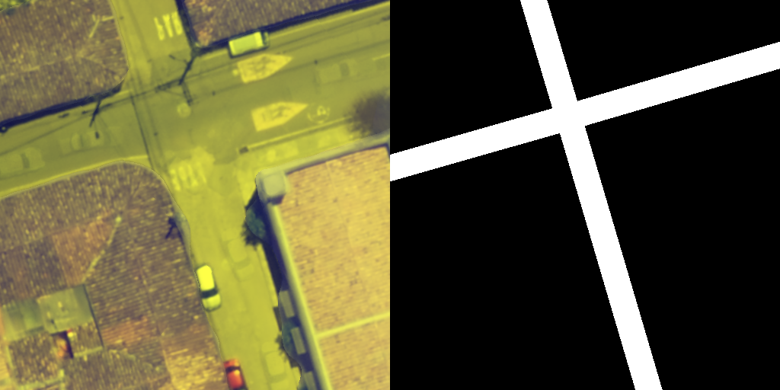
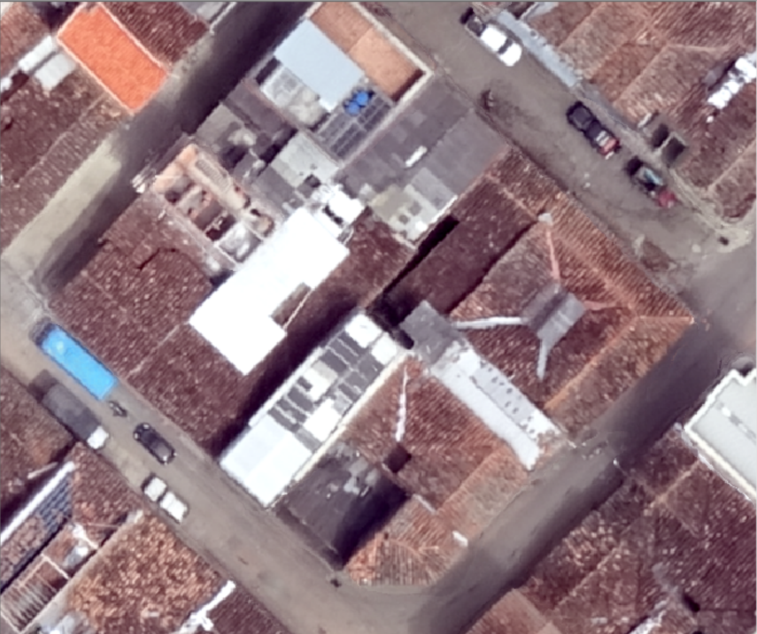
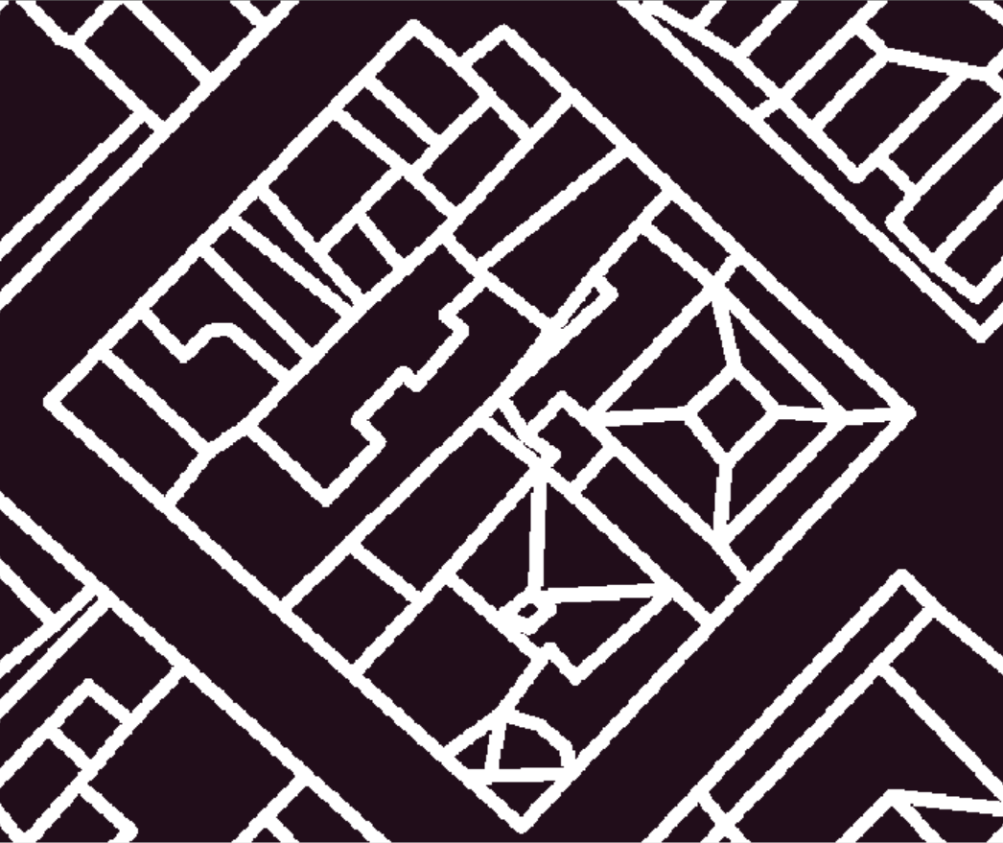
Primitive-mask the simplest raster representation of objects present in input images that allow models to learn objects’ structure and simplify their vectorization
Current vs Proposed Masks
Full-size mask
Equal-size mask
Color mask
(Image, Point primitive-mask), ex. Vehicles
(Image, Line primitive-mask), ex. Roads
(Image, Polygon primitive-mask), ex. Buildings
Ballesteros, J.R.; Sanchez-Torres, G.; Branch-Bedoya, J.W., 2022

Slide 9
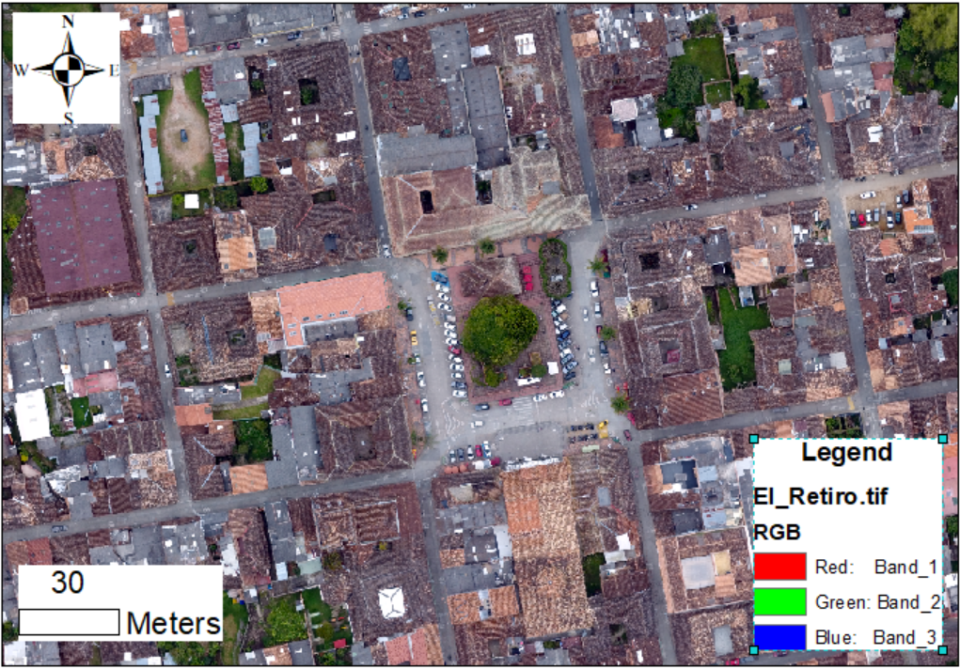
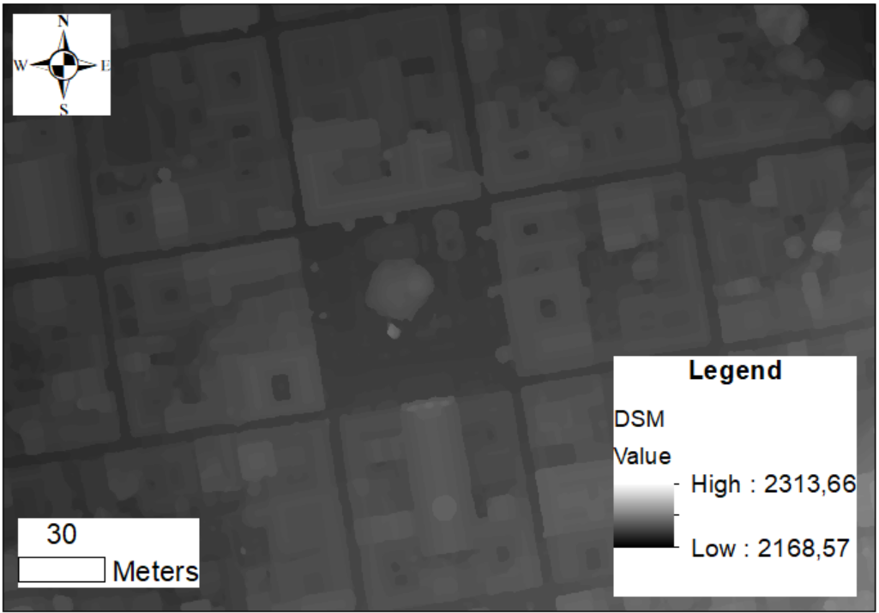
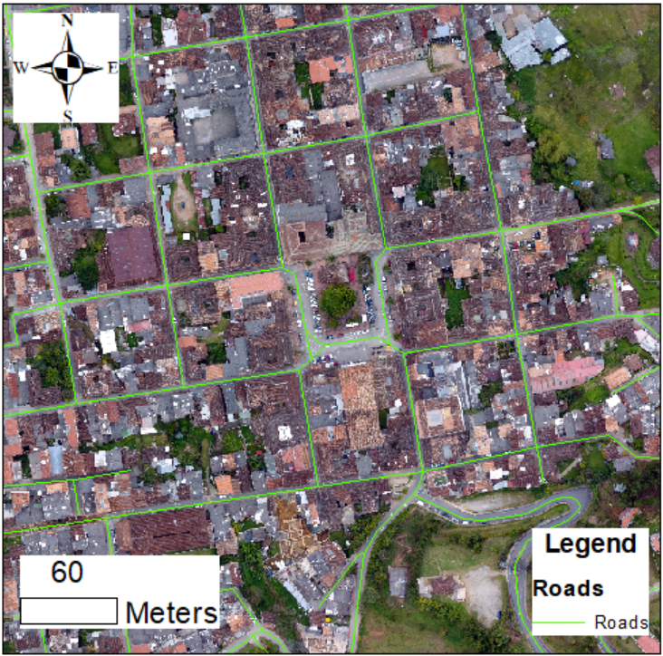
Drone Imagery Acquisition & Orthomosaic Production
Automatic flight
See
For an example of the result
(Crommelinck et al., 2017) employed opendronemap for UAV imagery acquisition for cadaster.
RGB
DSM
Vector roads from OSM

Slide 10
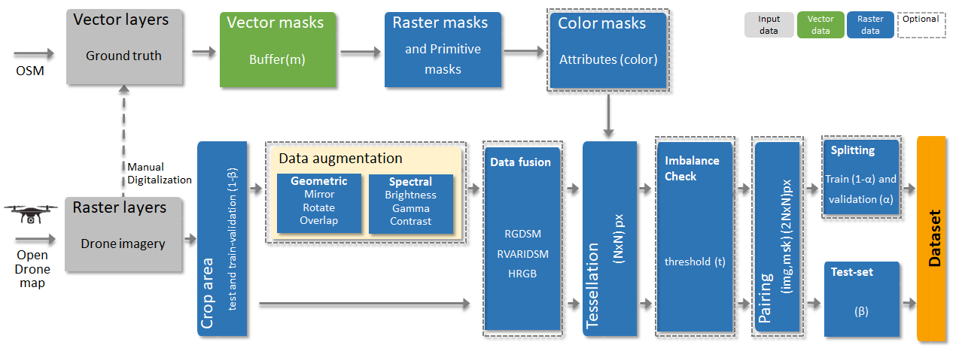
Proposed GIS Pipeline to Produce GeoAI Datasets from Drone Overhead Imagery
Ballesteros, John R., German Sanchez-Torres, and John W. Branch-Bedoya. 2022. "A GIS Pipeline to Produce GeoAI Datasets from Drone Overhead Imagery" ISPRS International Journal of Geo-Information 11, no. 10: 508. https://doi.org/10.3390/ijgi11100508

Slide 11
whole orthomosaic
a = Int(n*N)
(a)(1- β)
(a*β)
Orthomosaic area for training and validation
(b)(1-β)
b = Int(m*N)
Orthomosaic area for testing
(b*β)

Slide 12
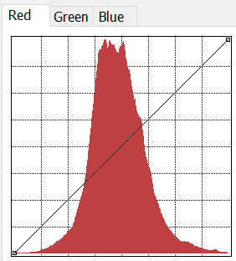
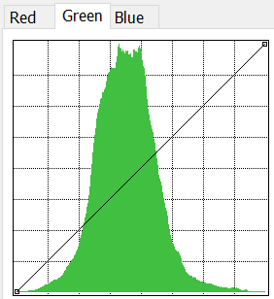
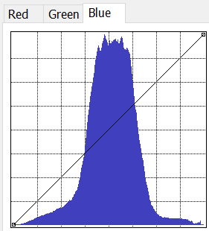
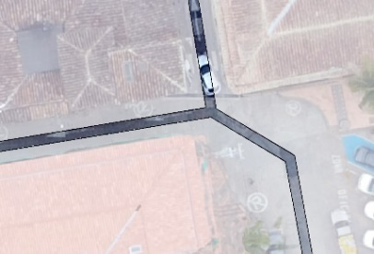
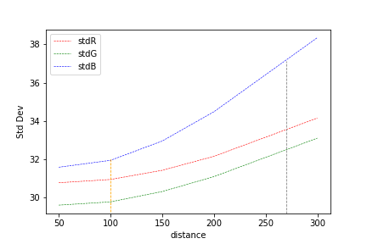
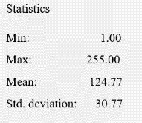
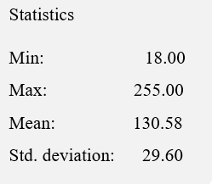
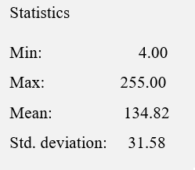
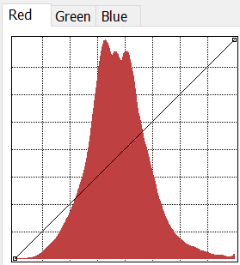
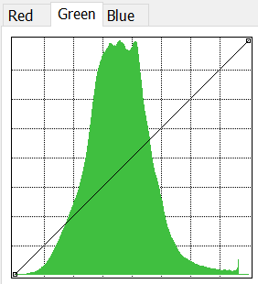
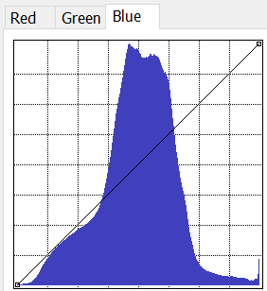
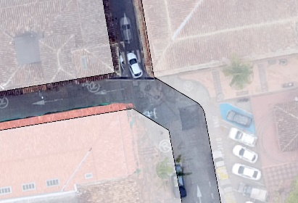
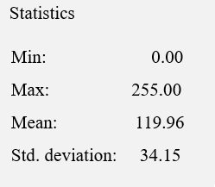
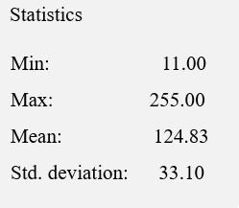
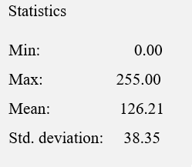
Producing Primitive Linear Masks
RGB pixel values distribution, f(d)
Buffer distance of masks and RGB pixel distribution
distance
Ballesteros, J.R.; Sanchez-Torres, G.; Branch-Bedoya, J.W., 2022

Slide 13
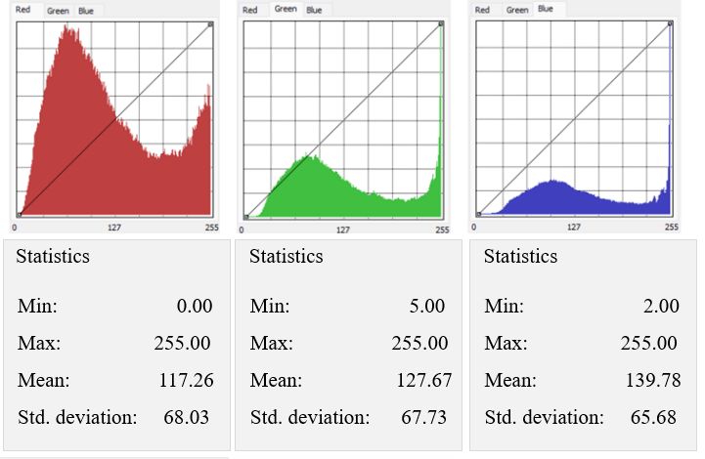
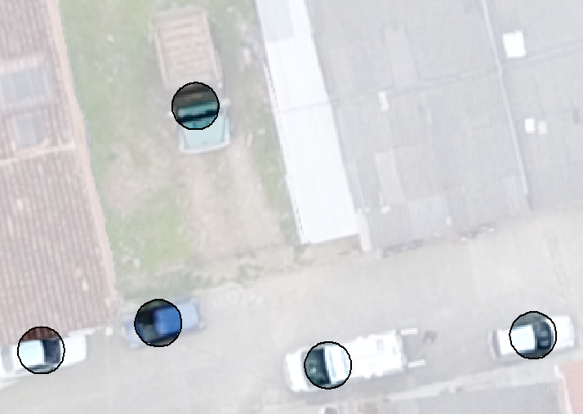
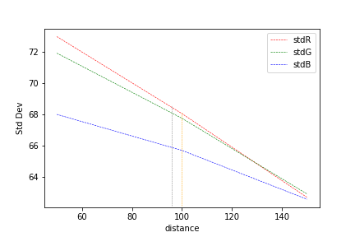
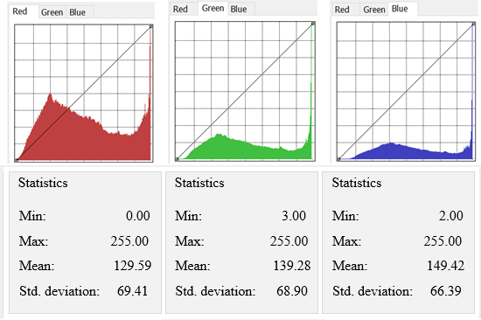
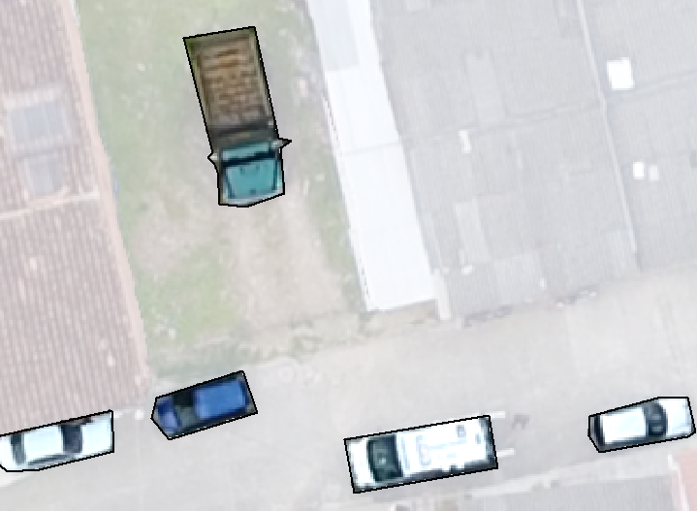
Producing Primitive Point Masks
RGB pixel values distribution, f(d)
distance
Buffer distance of masks and RGB pixel distribution
Ballesteros, J.R.; Sanchez-Torres, G.; Branch-Bedoya, J.W., 2022

Slide 14
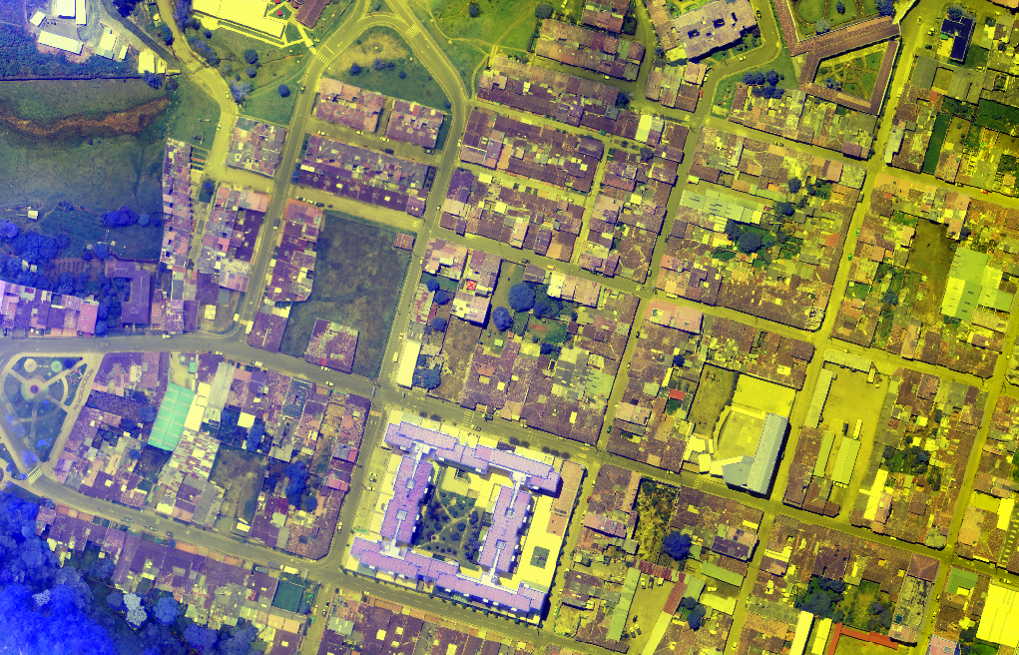
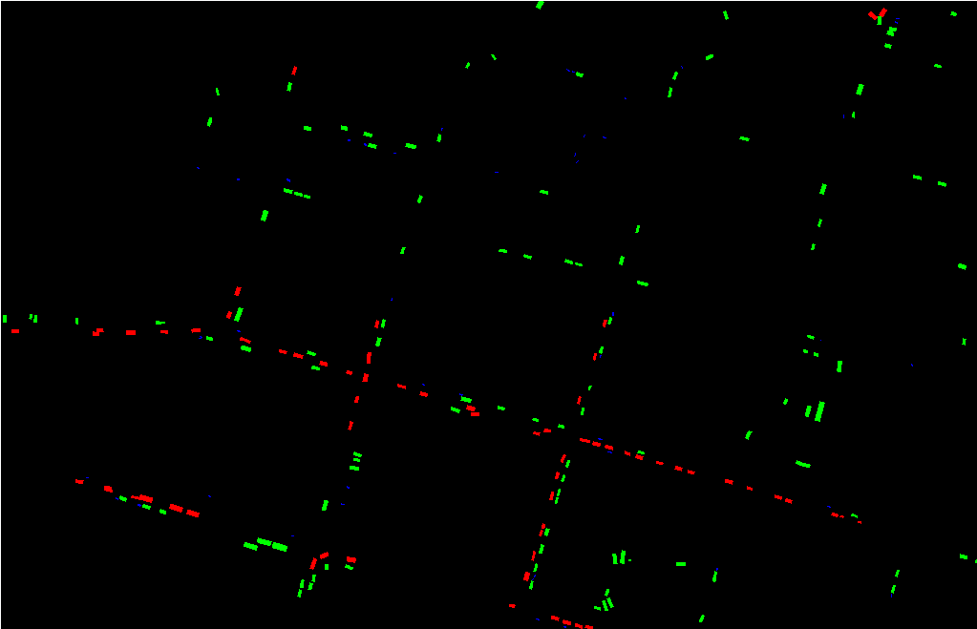
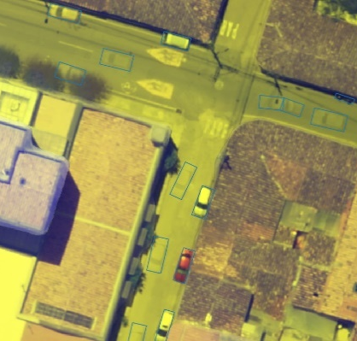
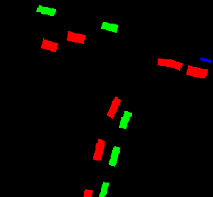
Ballesteros, J.R.; Sanchez-Torres, G.; Branch-Bedoya, J.W. HAGDAVS: Height-Augmented Geo-Located Dataset for Detection and Semantic Segmentation of Vehicles in Drone Aerial Orthomosaics. Data 2022, 7, 50. https://doi.org/10.3390/data7040050

Slide 15
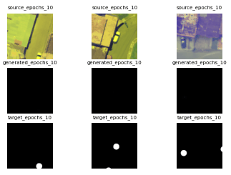
Vehicle Detection
Point masks, 1000 ex, 1m
256x256px
mIoU=0.978

Slide 16
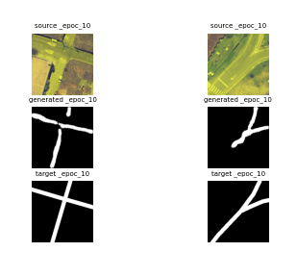
Line masks, 1098 ex., 1m
Road Centerline Segmentation using a road dataset
256x256px
mIoU=0.984

Slide 17
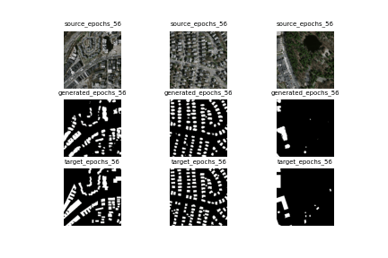
Building Footprint Segmentation
Polygon masks, 500 ex.

Slide 18
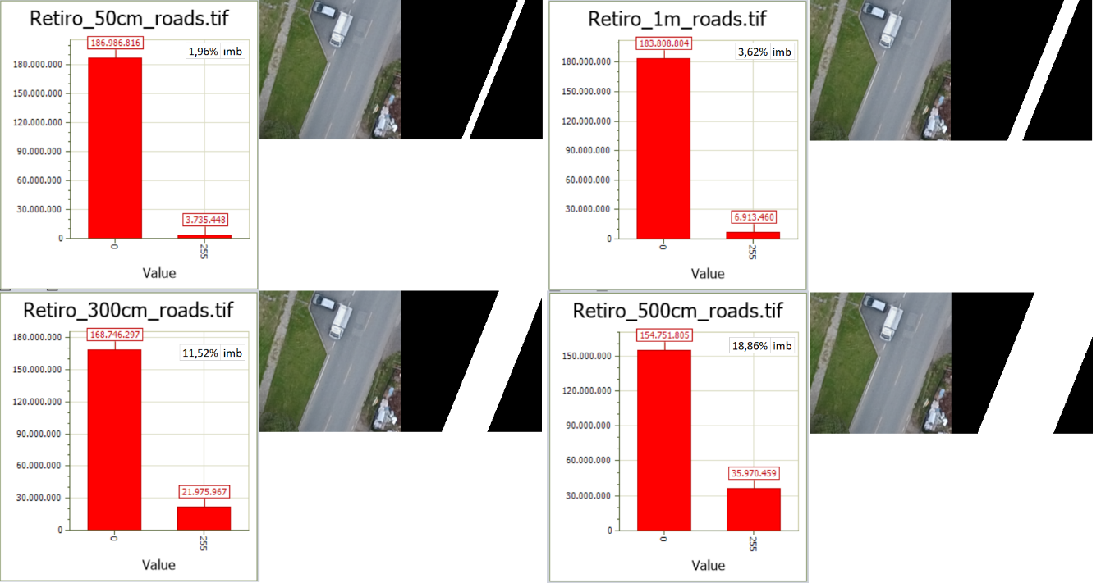
Imbalance on the Road Dataset
Imbalance vs buffer distance in roads
Example of a chip of 50 cm
These values are averaged for the entire raster masks not yet tessellated.
Example of a chip of 300 cm
Example of a chip of 500 cm

Slide 19
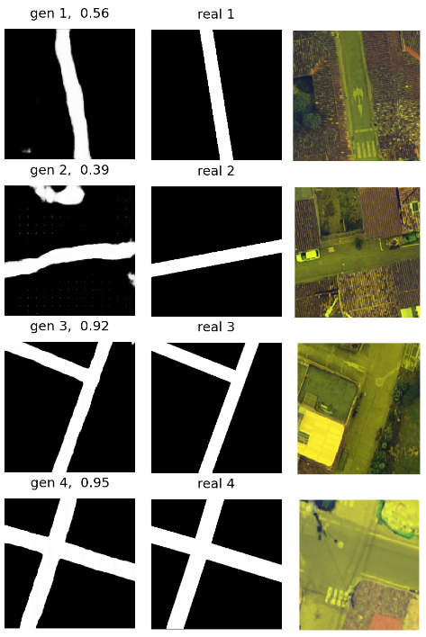
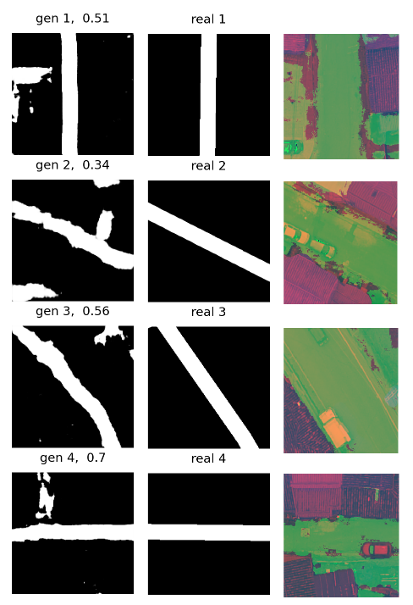
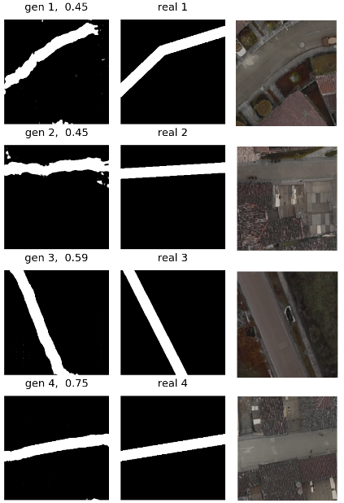

Data Fusion
RGDSM
RVARIB
HRGB
HRVARIB
(Zhang et al., 2015) and also (Al-Najjar et al., 2019) combined UAV Ultra-High resolution Orthophotos with DSM to create land cover maps, their experiments demonstrate that the DSM enhanced the results of RGB

Slide 20







Data Augmentation
Influence of geometric and spectral augmentation, 500 examples
30% overlapping
Augmentation Method | mIoU
Overlapping (30%) | 0.794
Mirroring (vert. and hor.) | 0.789
Rotation (10 degree increase clockwise) | 0.779
Spectral (10% random increase in brightness, intensity and contrast) | 0.659
All augmentation together | 0.847
90°mirroring
Influence of data fusion, 500 examples
Fusion Method | mIoU
RG-DSM | 0.725
RVARIB | 0.549
HRGB | 0.621
HRVARIB | 0.508
$$VARI = (Green − Red)/(Green + Red – Blue)$$
Gitelson et al, 2002

Slide 21


mIoU=0.000
mIoU=0.549
mIoU=0. 411
mIoU=0.477
mIoU=0.683
mIoU=0.455
mIoU=0.001
mIoU=0.621
mIoU=0. 557
mIoU=0.528
mIoU=0.503
mIoU=0.595

Slide 22

Objetivo 4. Validar usando conjuntos de datos de la literatura
~16% desbalanceado
Reported | mIoU (ours)
 | 0.937

Slide 23
References
1. Abdollahi, Abolfazl & Pradhan, Biswajeet & Shukla, Nagesh & Chakraborty, Subrata & Alamri, Abdullah. (2020). Deep Learning Approaches Applied to Remote Sensing Datasets for Road Extraction: A State-Of-The-Art Review. Remote Sensing. 12. 1444. 10.3390/rs12091444.
2. Adam Van Etten, Dave Lindenbaum, Todd Bacastow. SpaceNet: A Remote Sensing Dataset and Challenge Series. Computer Vision. 2019.
3. Alec Radford, et al. “Unsupervised Representation Learning with Deep Convolutional Generative Adversarial Networks“. ICLR 2016.
4. Al-Najjar, H.A.H.; Kalantar, B.; Pradhan, B.; Saeidi, V.; Halin, A.A.; Ueda, N.; Mansor, S. Land Cover Classification from fused DSM and UAV Images Using Convolutional Neural Networks. Remote Sens. 2019, 11, 1461. https://doi.org/10.3390/rs11121461
5. Arnadi Murtiyoso, Mirza Veriandi, Deni Suwardhi, Budhy Soeksmantono and Agung Budi Harto. Automatic Workflow for Roof Extraction and Generation of 3D CityGML Models from Low-Cost UAV Image-Derived Point Clouds. International Journal of Geo-Information, 2020.
6. Batra et al. Improved Road Connectivity by Joint Learning of Orientation and Segmentation. CVPR 2019.
7. Brownlee J. www.machinelearningmastery.com (accessed on 12 March 2020).
8. Bulatov, Dimitri & Häufel, Gisela & Böge, Melanie. (2016). VECTORIZATION OF ROAD DATA EXTRACTED FROM AERIAL AND UAV IMAGERY. ISPRS - International Archives of the Photogrammetry, Remote Sensing and Spatial Information Sciences. XLI-B3. 567-574. 10.5194/isprs-archives-XLI-B3-567-2016.
9. Crommelinck, Sophie & Bennett, Rohan & Gerke, Markus & Koeva, Mila & Yang, Michael Ying & Vosselman, George. (2017). SLIC Superpixels for Object Delineation from UAV Data. ISPRS Annals of Photogrammetry, Remote Sensing and Spatial Information Sciences. IV-2/W3. 9-16. 10.5194/isprs-annals-IV-2-W3-9-2017.

